Slide 1
Hypothesis Testing

Slide 2
What is hypothesis testing ?
Hypothesis testing is a statistical method that is used in making statistical decisions using experimental data. Hypothesis Testing is basically an assumption that we make about the population parameter.
Ex : You say avg height of citizens of city is more than 5.8 ft.
Votes for the politician will be more than 60%
All those example we assume need some statistic way to prove those. we need some mathematical conclusion what ever we are assuming is true.

Slide 3
Example
It is claimed that a process has been improved in yield by bringing a change in an important factor X. Yield data are collected from old and new processes.
Random samples are drawn from yield data from old process A and improved process B.
Process A Process B
89.7 | 84.7
81.4 | 86.1
84.5 | 83.2
84.8 | 91.9
87.3 | 86.3
79.7 | 79.3
85.1 | 82.6
81.7 | 89.1
83.7 | 83.7
84.5 | 88.5
“Is there real difference between Process A and Process B?”

Slide 4
Example: Hypothesis Testing
Real Question:
Can we say that the yield of improved Process B is greater than old Process A?
Descriptive Statistics
Variable | Process | N | Mean | Std. Dev.
Yield | A | 10 | 84.24 | 2.90
 | B | 10 | 85.54 | 3.65
Statistical Question:
Is there a statistically significant difference between mean of Process B (85.54) and mean of Process A (84.24)? Or, is this difference in mean just due to chance?

Slide 5
Hypothesis Testing
Develop the hypothesis for population and make statistical decision by determining the acceptance of hypothesis using sample data.
Example: Medicine B for treating headache that is newly developed by a pharmaceutical company has 30 minutes longer effect than existing Medicine A.
Null Hypothesis (H0): Argument made so far, or hypothesis saying that there is no change or difference
Alternative Hypothesis (H1): New argument, that is a hypothesis that you want to prove with solid ground obtained from sample
H0 : Medicine A and B have same effect
H1 : Medicine B has 30 minutes longer effect than Medicine A
Notes:
Lawyer judge, Angelina jolie

Slide 6
Procedure of Hypothesis Testing
The steps for hypothesis tests are as follows:
1. Define null and alternative hypotheses.
2. Identify the test statistic to be used for testing the validity of the null hypothesis, for example, Z-test or t-test.
3. Decide the significance value (Alpha). Typical value used for a is 0.05.
4. Calculate the p-value (probability value), which is the conditional probability of observing the
test statistic value when the null hypothesis is true. We will use the functions provided in scipy.stats module for calculating the p-value.
5. Take the decision to reject or retain the null hypothesis based on the p-value and the significance
value alpha a.

Slide 7
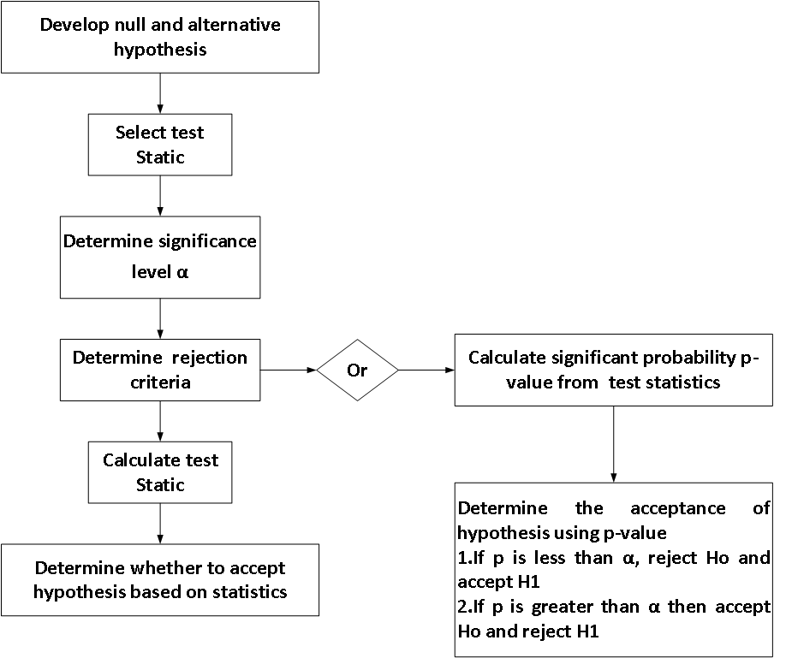

Procedure of Hypothesis Testing

Slide 8
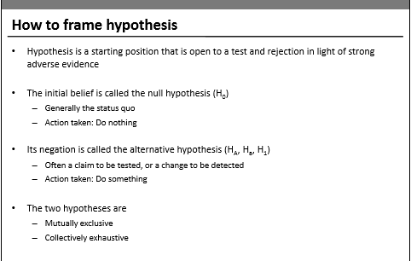
1-tail, 2-Tail
1-Sample, 2-Sample

Slide 9
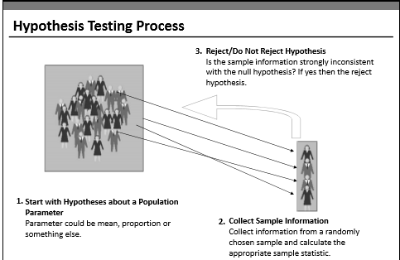

Slide 10
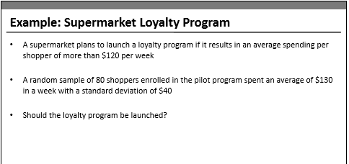
from scipy import stats
stats.norm.cdf(z)
stats.t.cdf(t,df=10)

Slide 11
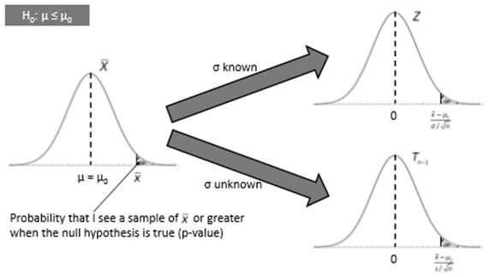

Slide 12
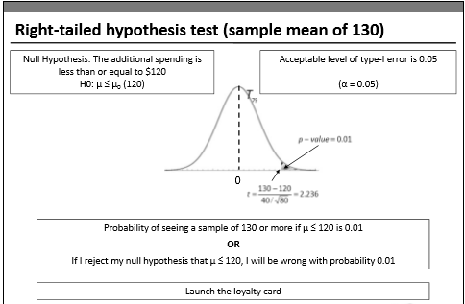
Notes:
The p-value is the probability that the t-statistic observed by chance under the assumption that NULL hypothesis is true.

Slide 13
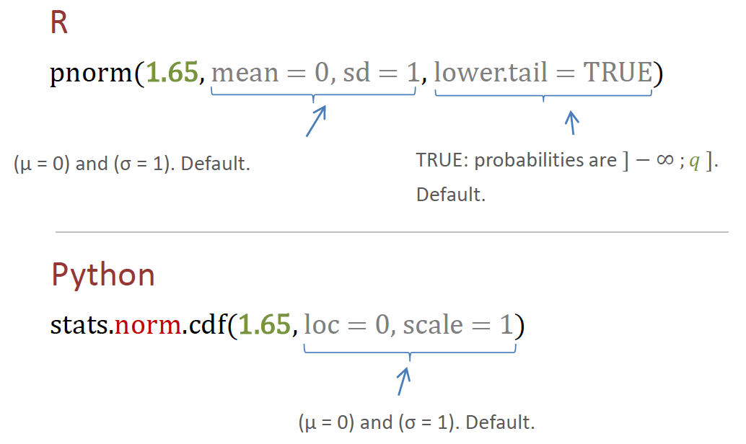
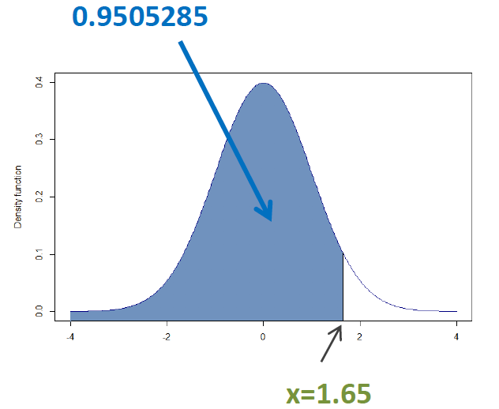
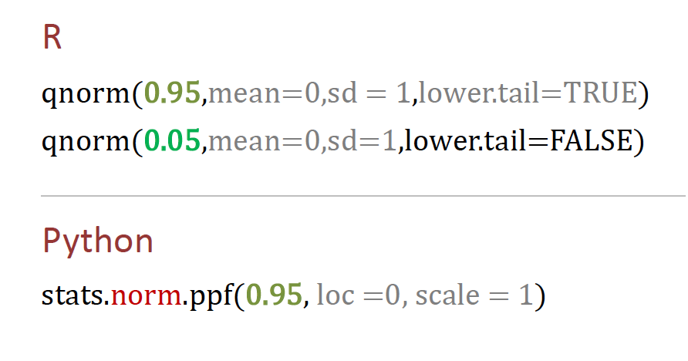
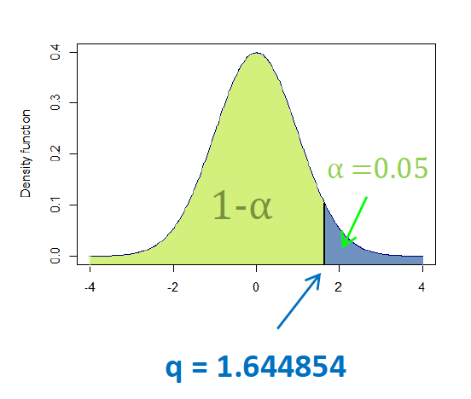
Normal Distribution codes

Slide 14
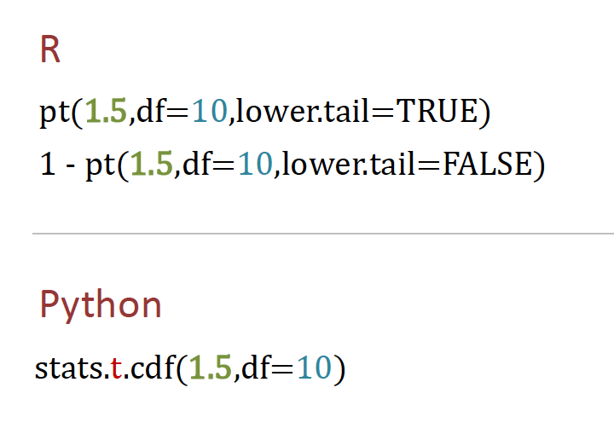
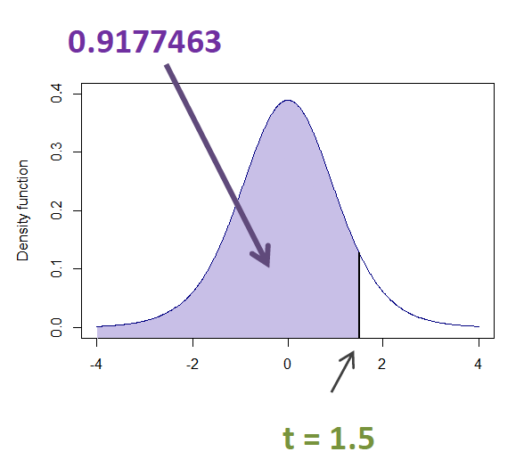
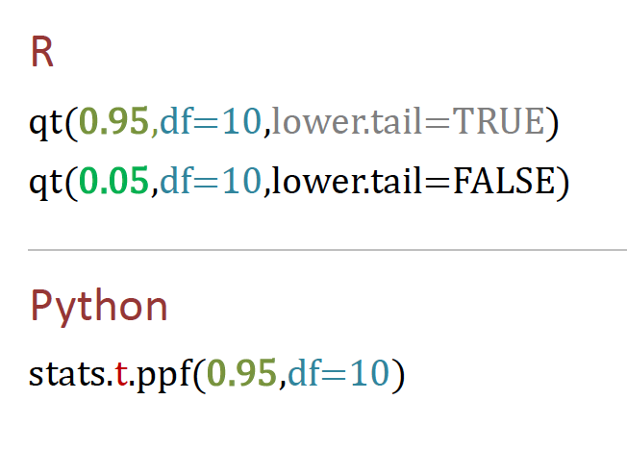
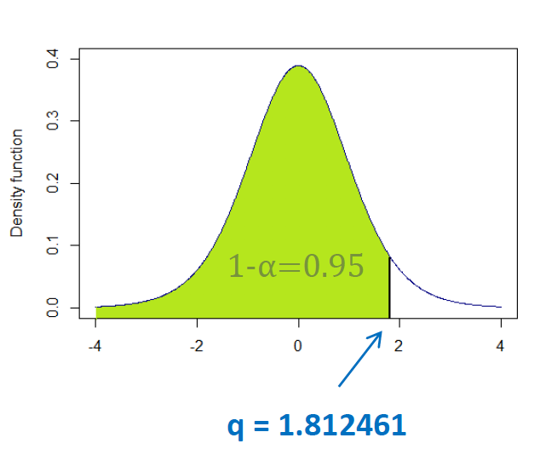
Student’ t- Distribution codes

Slide 15
Simple Exercise
Conducting a hypothesis test is a bit like putting accused person on trial in front of a jury.
The jury assumes that the accused person is innocent unless there is strong evidence against him, but even after considering the evidence,
it’s still possible for the jury to make wrong decisions

Slide 16

Simple Exercise
An accused person is on trial for a crime, and you’re on the jury. The jury’s
task is to assume the prisoner is innocent, but if there’s enough
evidence against him, they need to convict him.
In the trial, what’s the null hypothesis?
What’s the alternate hypothesis?
In what ways can the jury make a verdict that’s correct?
In what ways can the jury make a verdict that’s incorrect?

Slide 17
Simple Exercise
In the trial, what’s the null hypothesis?
The null hypothesis is that the prisoner is innocent, as that is what we have to assume until there’s proof otherwise.
What’s the alternate hypothesis?
The alternate hypothesis is that the prisoner is guilty. In other words, if there’s sufficient proof that the prisoner is not innocent, then we’ll accept that he’s guilty and convict him.

Slide 18
Simple Exercise
In what ways can the jury make a verdict that’s correct?
We can make a correct verdict if:
a) The prisoner is innocent, and we find him innocent.
b) The prisoner is guilty, and we find him guilty.
In what ways can the jury make a verdict that’s incorrect?
We can make an incorrect verdict if:
a) The prisoner is innocent, and we find him guilty.
b) The prisoner is guilty, and we find him innocent.

Slide 19
The errors we can make when conducting a hypothesis test are the same sort of errors we could make when putting a prisoner on trial
Hypothesis tests are basically tests where you take a claim and put it on trial by assessing the evidence against it. If there’s sufficient evidence against it, you reject it, but if there’s insufficient evidence against it, you accept it.
You may correctly accept or reject the null hypothesis, but even considering the evidence, it’s also possible to make an error. You may reject a valid null hypothesis, or you might accept it when it’s actually false

Slide 20
Statisticians have special names for these types of errors.
A Type I error is :
when you wrongly reject a true null hypothesis (Punished an innocent guy), and
A Type II error is :
when you wrongly accept a false null hypothesis (Let guilty go free).

Slide 21
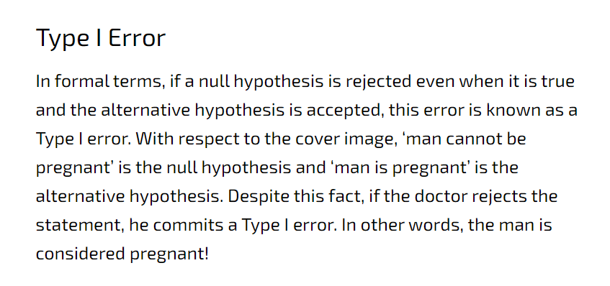

Slide 22
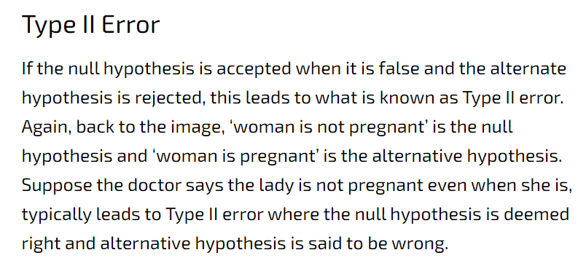

Slide 23
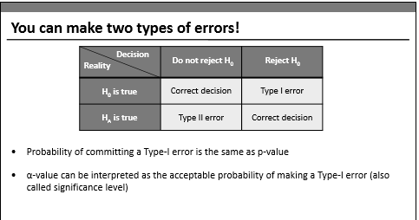
ERRORS
Actual Situation

Slide 24
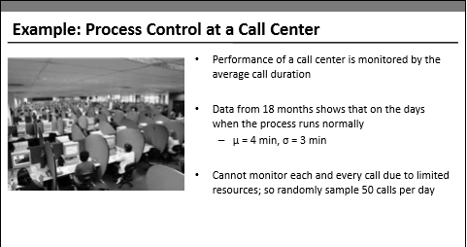

Slide 25
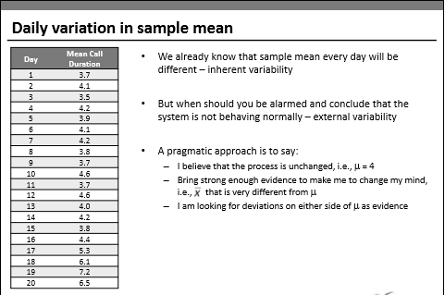

Slide 26
Let us solve the problem
Mean =4.0
Standard deviation =3
Sample Size =50
Sample mean =4.6
import scipy
import numpy as np
T statistic = (4-4.6)/(3/np.sqrt(50))
2*stats.t.cdf(-1.41,df=49)

Slide 27
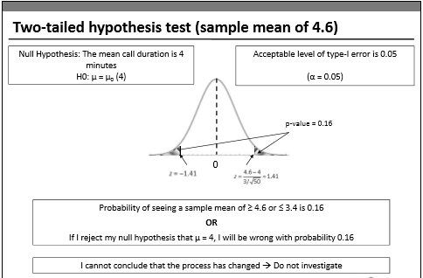

Slide 28
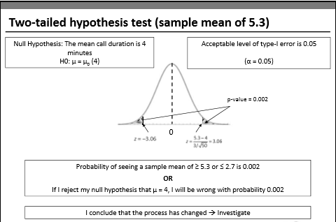

Slide 29
Let us do it in Python
scipy.stats.ttest_1samp(array,mu)

Slide 30
One-sample and one tail t-tests
Ex. An outbreak of Salmonella-related illness was attributed to ice cream produced at a certain factory. Scientists measured the level of Salmonella in 9 randomly sampled batches of ice cream. The levels (in MPN/g) were
0.593, 0.142, 0.329, 0.691, 0.231, 0.793, 0.519, 0.392, 0.418
Is there evidence that the mean level of Salmonella in the ice cream is greater than 0.3 MPN/g?
Let us try in Python

Slide 31
Let be the mean level of Salmonella in all batches of ice cream. Here the hypothesis of interest can be expressed as:
H0: <= 0.3
Ha: > 0.3
Data = pd.Series([0.593, 0.142, 0.329, 0.691, 0.231, 0.793, 0.519, 0.392, 0.418])
scipy.stats.ttest_1samp(data,0.3)

Slide 32
Two-sample t-tests
Ex. 6 subjects were given a drug (treatment group) and an additional 6 subjects a placebo (control group). Their reaction time to a stimulus was measured (in ms). We want to perform a two-sample t-test for comparing the means of the treatment and control groups.
Control : 91, 87, 99, 77, 88, 91
Treat :101, 110, 103, 93, 99, 104

Slide 33
Let Mu1 be the mean of the population taking medicine and Mu2 the mean of the untreated population. Here the hypothesis of interest can be expressed as:
H0: Mu1-Mu2=0
Ha: Mu1-Mu2 !=0
Control=pd.Series([91, 87, 99, 77, 88, 91])
Treat =pd.Series([101, 110, 103, 93, 99, 104])
stats.ttest_ind( control,Treat)
Ttest_indResult(statistic=-3.445612673536487, pvalue=0.006272124350809803)

Slide 34
2 Proportion t test

Slide 35
Usecase : Is there a significant difference between the population proportions of state 1 and state 2 who report that they have been placed immediately after education?
Populations: All Students who have completed graduation and Post graduation in both both states Parameter of Interest: p1 — p2, where p1 = state1 and p2 = state2
Data: 247 students from state 1. 36.8% of students report that they have got the job.
308 students from state 2. 38.9% of students report that they have got the job.
Hypothesis Definition:
Null Hypothesis: p1 - p2 = 0 Alternative Hypothesis: p1 -p2 ≠ 0

Slide 36
The difference in population proportion needs t-test. Also, the population follows a binomial distribution here. We can just pass on the two population quantities with the appropriate binomial distribution parameters to the t-test function
We can use the ttest_ind() function from Statsmodels.
The function returns three values: (a) test statistic, (b) p-value of the t-test, and (c) degrees of freedom used in the t-test
Data Given:
n1 = 247 p1 = .37 n2 = 308 p2 = .39

Slide 37
Thank you

